Slide 1
SIT-792 Minor Thesis
Topic: Cloud Connected IoT
Student Name: Sahil Deshpande
Student ID: 215168645
Supervisor: Dr. Atul Sajjanhar
Unit Chair: Dr. Shui Yu

Slide 2
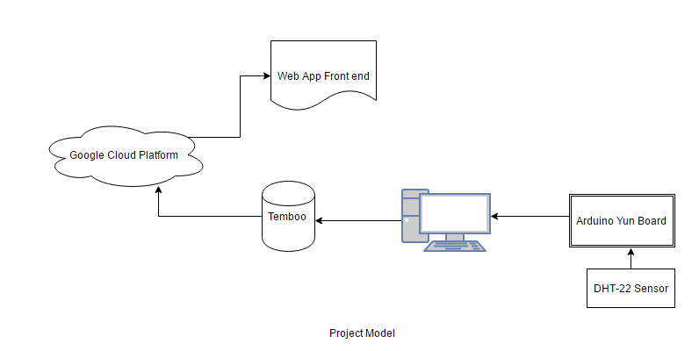
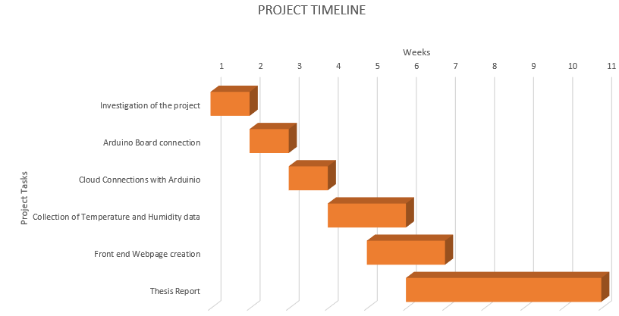
Cloud-Based Weather Station
Weather data collected from sensor and stored on cloud and displayed in a webpage.
Uses Arduino Yun, DHT-22 Sensor, Temboo Web-service, Google Cloud Platform
Importance- Versatile Nature, more cheaper.
Research Problems & Related Work
Identification of apt web-service.
Suitable software for retrieving sensor data.
To record Arduino readings into the cloud.
Earlier people had to rely on news channels & weather stations for temperature data.
Arduino Board is capable of monitoring sensor data.
Methodology
Project Timeline

Slide 3
THANK YOU

